Slide 1
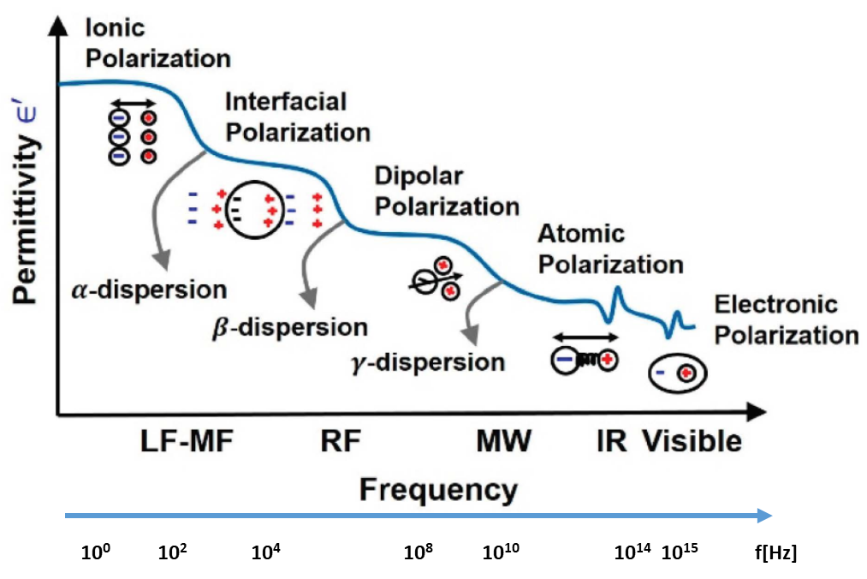

1.3 Classical dispersion theory
Frequency response of polarization
$$\vec{P}=ε_{0}\left(ε−1\right)\vec{E}$$

Slide 2
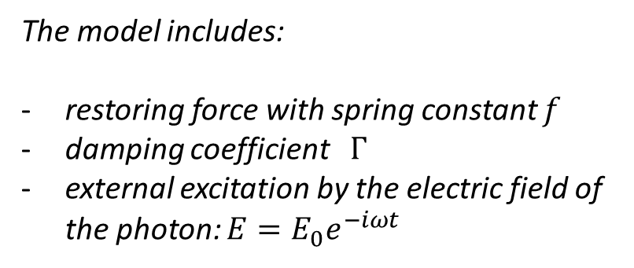
In 1880 Lorentz applied a simple mechanic atomic theory to explain dispersion behavior in insulators at frequencies close to an absorption band.
The model includes:
restoring force with spring constant $f$
damping coefficient $Γ$
external excitation by the electric field of the photon: $E=E_{0}e^{−iωt}$

Slide 3
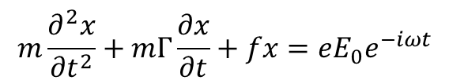
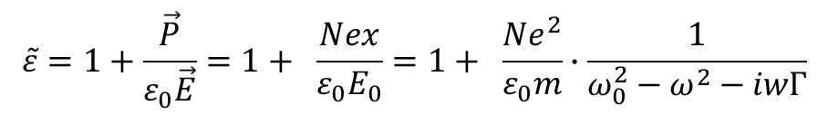

Damped oscillator according to Newton’s law of motion:
$$m\frac{∂^{2}x}{{∂t}^{2}}+mΓ\frac{∂x}{∂t}+fx=eE_{0}e^{−iωt}$$
(1)
The solution of this differential equation is:
$x=\frac{eE_{0}e^{−iωt}}{m\left(ω_{0}^{2}−ω^{2}−iwΓ\right)}$ where $ω_{0}=\sqrt{f/m}$ is the resonance frequency of the free oscillator.
For a concentration of N electrons per Volume, the total polarizability $P$ is:
$P=N∙ex$ and with ${\vec{P}=ε}_{0}\left(\tilde{ε}−1\right)\vec{E}$ we have :
$$\tilde{ε}=1+\frac{\vec{P}}{ε_{0}\vec{E}}=1+ \frac{Nex}{ε_{0}E_{0}}=1+ \frac{Ne^{2}}{ε_{0}m}∙\frac{1}{ω_{0}^{2}−ω^{2}−iwΓ}$$
(2)

Slide 4
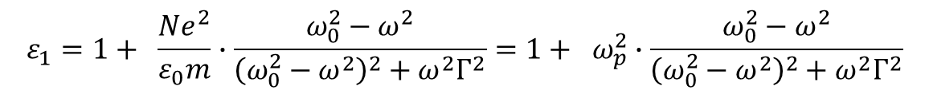
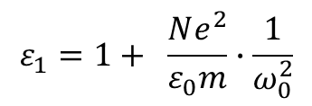
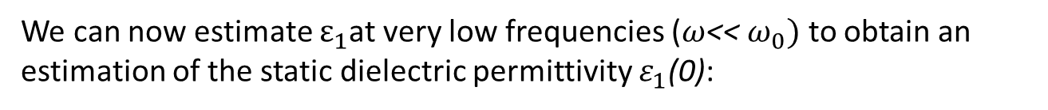

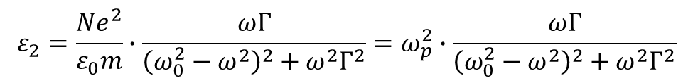
Expression (2) can be split into the real and imaginary part of permittivity according to $\tilde{ε}=ε_{1}+{iε}_{2}$:
$$ε_{1}=1+ \frac{Ne^{2}}{ε_{0}m}∙\frac{ω_{0}^{2}−ω^{2}}{{\left(ω_{0}^{2}−ω^{2}\right)}^{2}+ω^{2}Γ^{2}}=1+ ω_{p}^{2}∙\frac{ω_{0}^{2}−ω^{2}}{{\left(ω_{0}^{2}−ω^{2}\right)}^{2}+ω^{2}Γ^{2}}$$
(3)
$$ε_{2}=\frac{Ne^{2}}{ε_{0}m}∙\frac{ωΓ}{{\left(ω_{0}^{2}−ω^{2}\right)}^{2}+ω^{2}Γ^{2}}=ω_{p}^{2}∙\frac{ωΓ}{{\left(ω_{0}^{2}−ω^{2}\right)}^{2}+ω^{2}Γ^{2}}$$
with $ω_{p}^{2}=\frac{Ne^{2}}{ε_{0}m}$
(4)
We can now estimate $ε_{1}$at very low frequencies ($ω$<< $ω_{0})$ to obtain an estimation of the static dielectric permittivity $ε_{1}$(0):
$$ε_{1}=1+ \frac{Ne^{2}}{ε_{0}m}∙\frac{1}{ω_{0}^{2}}$$
With typical solid state parameters, i.e. $ω_{0}={1.51∙10}^{15}s^{−1}$(1eV) and $N={10}^{22}{cm}^{−3}$ we obtain $ε_{1}$=15 which gives a value of $n$=3.8 for the static dielectric constant which is astonishingly close to typical values for dielectrics.

Slide 5





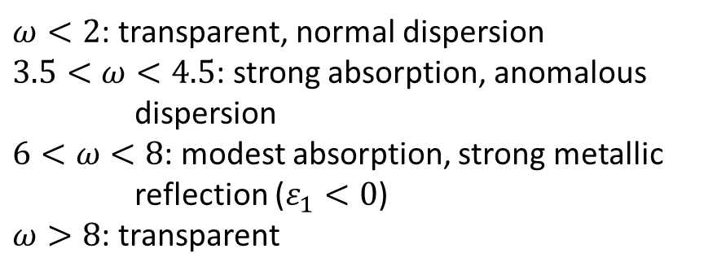







A short discussion of the optical constants close to a resonance
$$ω_{0}$$
$$ω_{p}$$
$$ω_{0}$$
$$ω_{p}$$
$$ε_{1}$$
$$ε_{2}$$
$$n$$
$$k$$
$$ω$$
$$ω$$
$ω<2$: transparent, normal dispersion
$3.5<ω<4.5$: strong absorption, anomalous
dispersion
$6<ω<8$: modest absorption, strong metallic
reflection ($ε_{1}<0$)
$ω>8$: transparent
$$R$$
$$ω$$

Slide 6

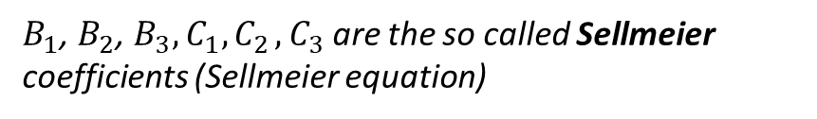

Empirical dispersion relations (Cauchy, Sellmeier)
For the low frequency tail of the dielectric function $ε_{1}≈n^{2}$ Cauchy has proposed an empirical relationship which is frequently used for modeling the optical constants on the low energy side:
B, C, D are the so called Cauchy coefficients (Cauchy dispersion relation).
$$n\left(λ\right)=B+\frac{C}{λ^{2}}+\frac{D}{λ^{4}}$$
$$n^{2}\left(λ\right)=1+\frac{B_{1}λ^{2}}{λ^{2}−C_{1}}+\frac{B_{2}λ^{2}}{λ^{2}−C_{2}}+\frac{B_{3}λ^{2}}{λ^{2}−C_{3}}$$
Some typical examples (glasses)
$B_{1}$, $B_{2}$, $B_{3},C_{1}{, C}_{2},C_{3}$ are the so called Sellmeier coefficients (Sellmeier equation)

Slide 7



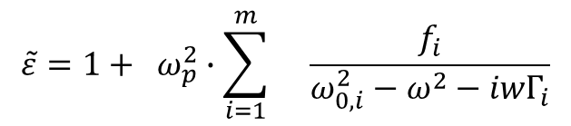


The Lorentz Model can be extended for multiple oscillators:
$$\tilde{ε}=1+ ω_{p}^{2}∙\sum_{i=1}^{m}{}\frac{f_{i}}{ω_{0,i}^{2}−ω^{2}−iwΓ_{i}}$$
where $f_{i}$ is the oscillator strength.
$$ε_{1}$$
$$ε_{opt}$$
$$1$$
$$ω$$

Slide 8
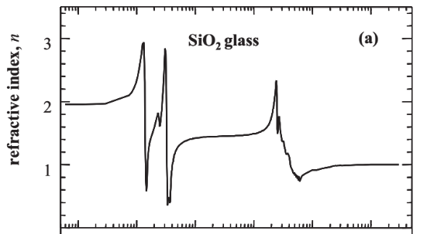
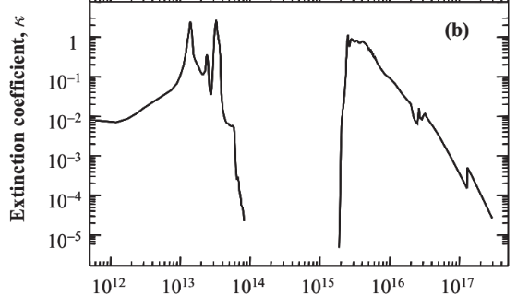


Optical constants of fused silica (SiO₂)
Palik, E.D. (1985). Handbook of the optical constants of solids. Academic Press, San Diego.

Slide 9
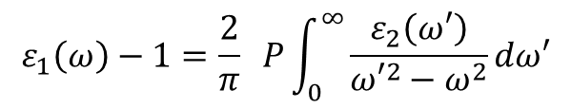
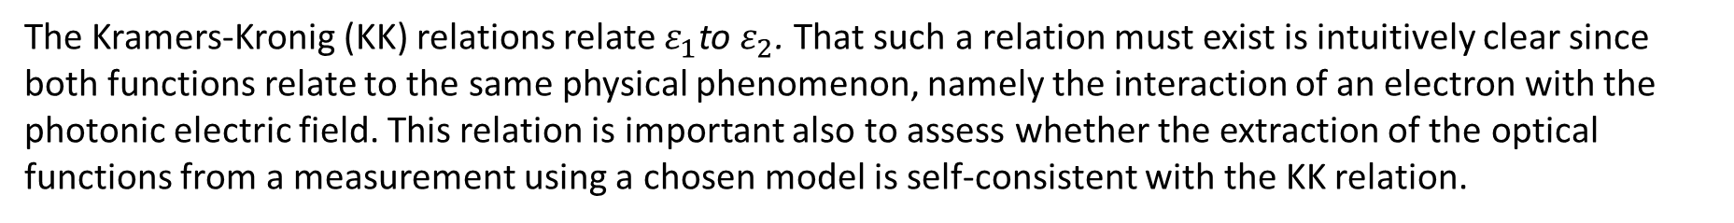
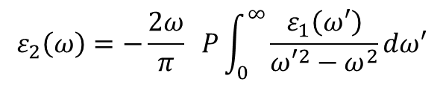
Kramers-Kronig relation
The Kramers-Kronig (KK) relations relate $ε_{1}$to $ε_{2}$. That such a relation must exist is intuitively clear since both functions relate to the same physical phenomenon, namely the interaction of an electron with the photonic electric field. This relation is important also to assess whether the extraction of the optical functions from a measurement using a chosen model is self-consistent with the KK relation.
$$ε_{1}\left(ω\right)−1=\frac{2}{π} P\int_{0}^{∞}{\frac{ε_{2}\left(ω′\right)}{{ω′}^{2}−ω^{2}}dω′}$$
(5)
$$ε_{2}\left(ω\right)=−\frac{2ω}{π} P\int_{0}^{∞}{\frac{ε_{1}\left(ω′\right)}{{ω′}^{2}−ω^{2}}dω′}$$

Slide 10
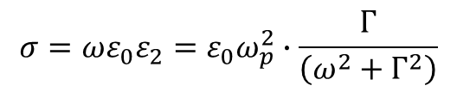

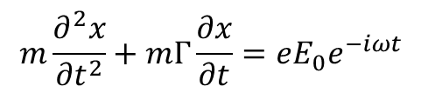
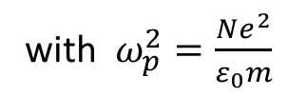
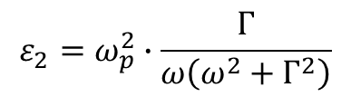
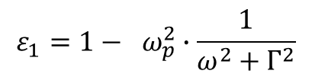
Free electrons – the Drude –Zener model for metals
We can use the same approach as Lorentz, omitting the restoring force (which actually means that the resonance frequency is zero in this case):
$$m\frac{∂^{2}x}{{∂t}^{2}}+mΓ\frac{∂x}{∂t}=eE_{0}e^{−iωt}$$
(6)
Similarly as before, we can find the dielectric function as follows including $ε_{opt}$ to allow for optical transitions:
$$ε_{1}=1− ω_{p}^{2}∙\frac{1}{ω^{2}+Γ^{2}}$$
(7)
$$ε_{2}=ω_{p}^{2}∙\frac{Γ}{ω\left(ω^{2}+Γ^{2}\right)}$$
with $ω_{p}^{2}=\frac{Ne^{2}}{ε_{0}m}$
(8)
Optical conductivity follows from $ε_{2}=$ $\frac{σ}{ωε_{0}}$:
$$σ=ωε_{0}ε_{2}={ε_{0}ω}_{p}^{2}∙\frac{Γ}{\left(ω^{2}+Γ^{2}\right)}$$
(9)

Slide 11
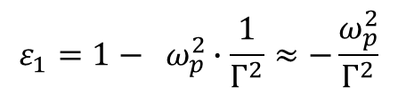
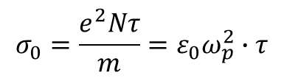

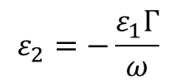
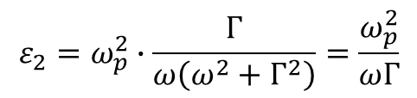
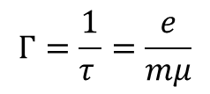


a) At $ω=0$ the optical conductivity must equal the DC conductivity which is:
$$σ_{0}=\frac{e^{2}Nτ}{m}={ε_{0}ω}_{p}^{2}∙τ$$
,where $τ$ is the relaxation time or time between electron collisions.
Comparison with the optical conductivity provides:
$$Γ=\frac{1}{τ }=\frac{e}{mμ}$$
, using the free electron model
From here, we can estimate the mobility in metals assuming a damping factor $Γ={1.53∙10}^{13}s^{−1} \left(0.01 eV\right)$ similar to the phonon energy. From $μ=\frac{e}{mΓ}=0.012m^{2}V^{−1}s^{−1}=120{ cm}^{2}V^{−1}s^{−1}$ being representative for e.g. alkali metals.
Analysis of the optical properties in the low and high energy regime
b) $\frac{ω}{Γ}≪1$
From (7) and $ω≪Γ$:
From (8) and $ω≪Γ$:
$$ε_{1}=1− ω_{p}^{2}∙\frac{1}{Γ^{2}}≈−\frac{ω_{p}^{2}}{Γ^{2}}$$
$$ε_{2}=ω_{p}^{2}∙\frac{Γ}{ω\left(ω^{2}+Γ^{2}\right)}=\frac{ω_{p}^{2}}{ωΓ}$$
$$ε_{2}=−\frac{ε_{1}Γ}{ω}$$
(10)

Slide 12
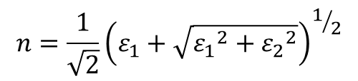

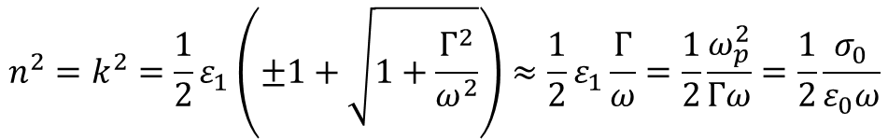
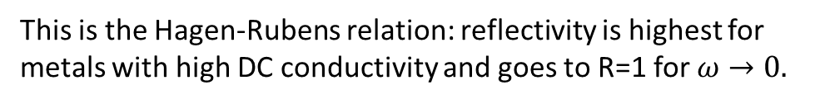
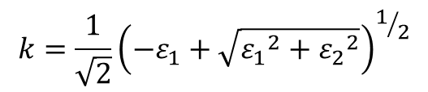
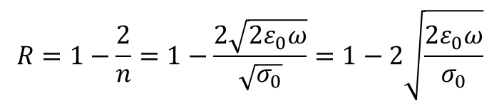
From $\tilde{ε}= {\tilde{n}}^{2}$ we can obtain:
$$n=\frac{1}{\sqrt{2}}{\left(ε_{1}+\sqrt{{ε_{1}}^{2}+{ε_{2}}^{2}}\right)}^{1/2}$$
$$k=\frac{1}{\sqrt{2}}{\left(−ε_{1}+\sqrt{{ε_{1}}^{2}+{ε_{2}}^{2}}\right)}^{1/2}$$
By inserting (10) in above formulas and using $ω/Γ≪1$ we obtain:
$$n^{2}=k^{2}=\frac{1}{2}ε_{1}\left(±1+\sqrt{1+\frac{Γ^{2}}{ω^{2}}}\right)≈\frac{1}{2}ε_{1}\frac{Γ}{ω}=\frac{1}{2}\frac{ω_{p}^{2}}{Γω}=\frac{1}{2}\frac{σ_{0}}{ε_{0}ω}$$
(11)
For the last equation we used $σ_{0}={ε_{0}ω}_{p}^{2}∙τ$ for the DC conductivity. At perpendicular incidence we have at the air metal interface:
$R=\frac{{(n−1)}^{2}+k^{2}}{{(n+1)}^{2}+k^{2}}=\frac{{(n+1)}^{2}−4n+k^{2}}{{(n+1)}^{2}+k^{2}}=1−\frac{4n}{{\left(n+1\right)}^{2}+k^{2}}≈1−\frac{4n}{2n^{2}}=1−\frac{2}{n}$ and replacing n according to (11) we have:
$$R=1−\frac{2}{n}=1−\frac{2\sqrt{2ε_{0}ω}}{\sqrt{σ_{0}}}=1−2\sqrt{\frac{2ε_{0}ω}{σ_{0}}}$$
This is the Hagen-Rubens relation: reflectivity is highest for metals with high DC conductivity and goes to R=1 for $ω→0.$

Slide 13
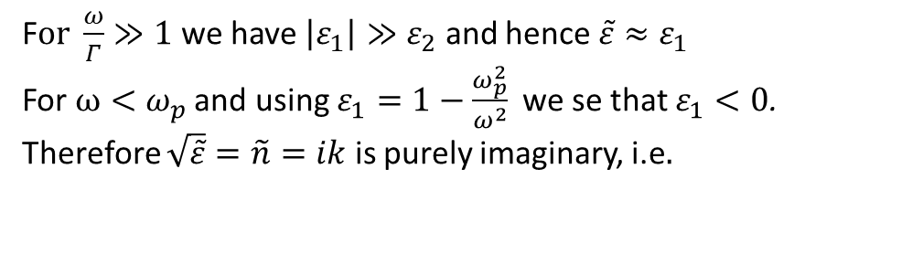
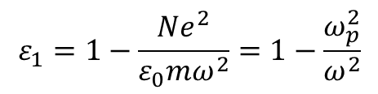

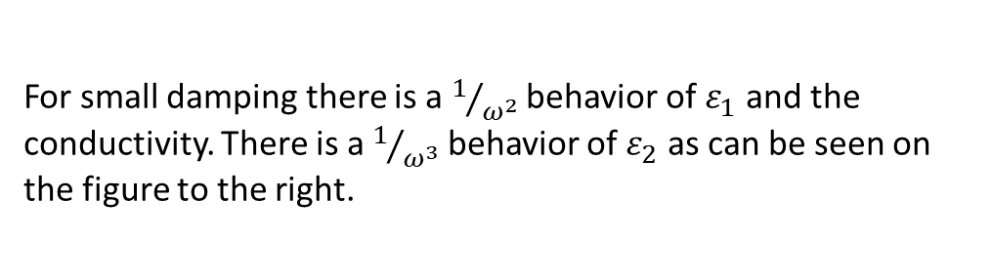

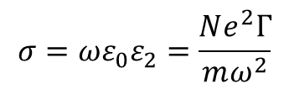
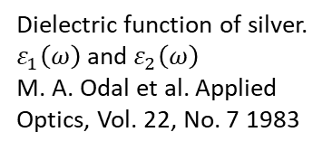
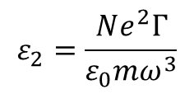
c) $\frac{ω}{Γ}≫1$
From (7) and (8) we get:
$$ε_{1}=1−\frac{Ne^{2}}{ε_{0}mω^{2}}=1−\frac{ω_{p}^{2}}{ω^{2}}$$
$$ε_{2}=\frac{Ne^{2}Γ}{ε_{0}mω^{3}}$$
$$σ=ωε_{0}ε_{2}=\frac{Ne^{2}Γ}{mω^{2}}$$
or
For small damping there is a $1/{ω^{2}}$ behavior of $ε_{1}$ and the conductivity. There is a $1/{ω^{3}}$ behavior of $ε_{2}$ as can be seen on the figure to the right.
Dielectric function of silver. $ε_{1}\left(ω\right)$ and $ε_{2}\left(ω\right)$
M. A. Odal et al. Applied Optics, Vol. 22, No. 7 1983
F$or \frac{ω}{Γ}≫1$ we have $\left|ε_{1}\right|≫ε_{2}$ and hence $\tilde{ε}≈ε_{1}$
For $ω<ω_{p}$ and using $ε_{1}=1−\frac{ω_{p}^{2}}{ω^{2}}$ we se that $ε_{1}<0$.
Therefore $\sqrt{\tilde{ε}}=\tilde{n}=ik$ is purely imaginary, i.e$.$
$n=0$ and $R=\frac{{(n−1)}^{2}+k^{2}}{{(n+1)}^{2}+k^{2}}≈\frac{1+k^{2}}{1+k^{2}}=1$
It follows that the reflectivity of metals is R=100% below the plasma frequency.

Slide 14
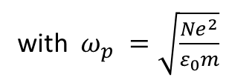


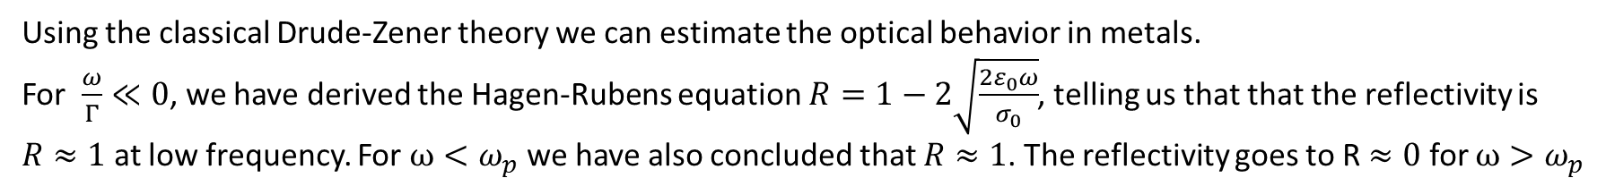


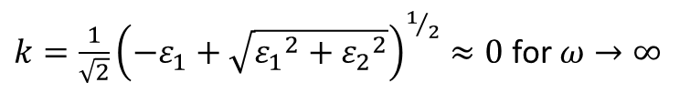

For $ω>ω_{p}$ the medium acts as a transparent dielectric and may have some resonances due to interband transitions. At high frequency, it behaves as a non absorbing medium. Since $ε_{2}≈0$ for $ω→∞$ we have
$k=\frac{1}{\sqrt{2}}{\left(−ε_{1}+\sqrt{{ε_{1}}^{2}+{ε_{2}}^{2}}\right)}^{1/2}≈0$ for $ω→∞$
Since $ε_{1}≈1$ for $ω→∞$ we also have R=0 for $ω→∞$
Summary of the reflective properties of metals
Using the classical Drude-Zener theory we can estimate the optical behavior in metals.
For $\frac{ω}{Γ}≪0$, we have derived the Hagen-Rubens equation $R=1−2\sqrt{\frac{2ε_{0}ω}{σ_{0}}}$, telling us that that the reflectivity is $R≈1$ at low frequency. For $ω<ω_{p}$ we have also concluded that $R≈1$. The reflectivity goes to R $≈0$ for $ω>ω_{p}$
$$R$$
$$1$$
plasma edge
with $ω_{p}^{}=\sqrt{\frac{Ne^{2}}{ε_{0}m}}$
$$0$$
$$ω$$
$$ω_{p}$$

